Slide 1





DEV:PICOO
Group 5
Made by Gebriel, Damian and Kymani.

Slide 2

Project goal
1
Develop a functional web prototype of a Picoo quiz tool to easily create, edit, and manage quizzes in a user-friendly way.
Requiremants
Add, edit, delete functionality
Test with teachers
Make it as interactive as posible

Slide 3

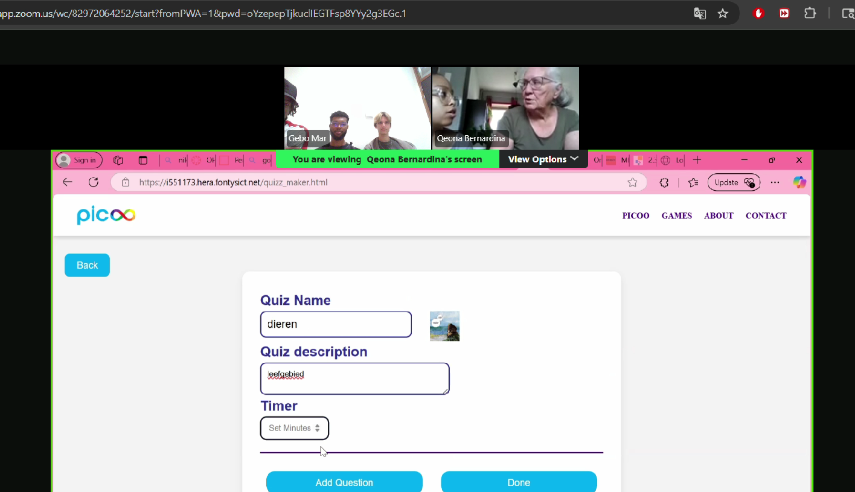
User test and feedback
1
Remade create quizz button
Added check mark for right answer
Moved the done button
Added check mark to the preview

Slide 4

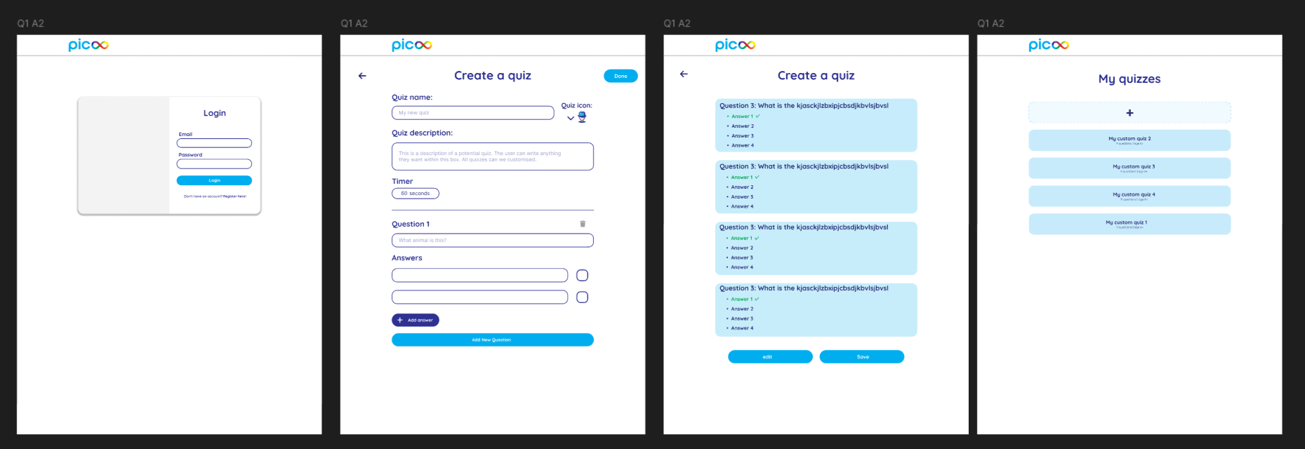
Design Process
4
Combined our designs

Slide 5
Demo
6
QUIZTAFETTE QUIZTAFETTE QUIZTAFETTE QUIZTAFETTE QUIZTAFETTE QUIZTAFETTE QUIZTAFETTE QUIZTAFETTE QUIZTAFETTE

